Slide 1
Team 5 – Rotor Blade Structures
Week No - 13
Date - 16.12.2025
Supervisor - Dr. Laurence Alhrshy
Presented by – ------ (700000)
Team Members - Bhima B Masare, Anudeep Allanki, Dongsuk Kim, Mithun Shetty

Slide 2
Contents
1. Rotor Blade Structures Team Time line
2. Tasks planned for Project
3. Spar Cap –
3.1 Blade Design using NuMAD
3.2 Developing the Blade of WEC 2025 Optimus Syria in NuMAD (Test 4)
3.3 Updated Results (Update from Week 11)
Bibliography
Bhima Babu Masare

Slide 3
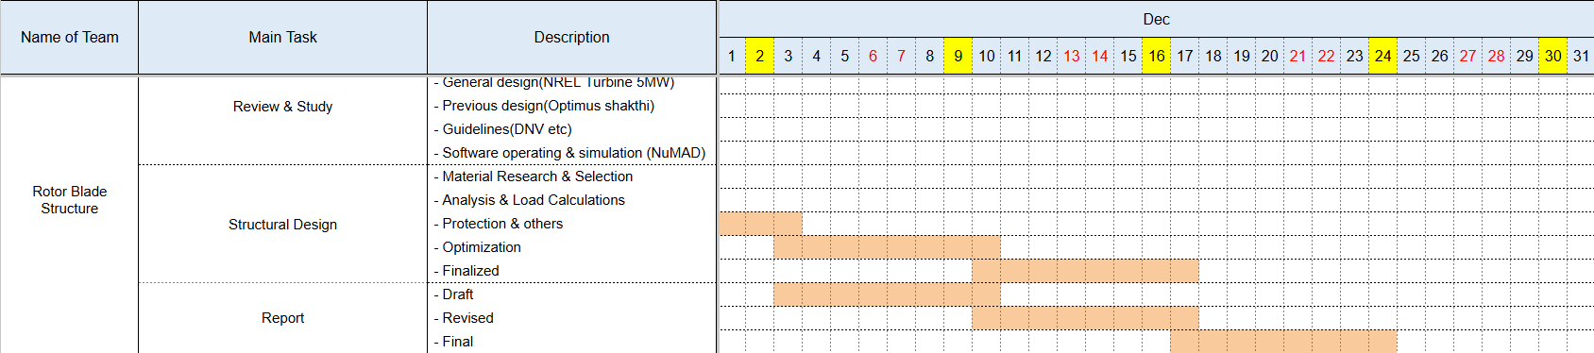
1. Rotor Blade Structures Team Time line -
1.1 Team Time line for Month December -
--------------------

Slide 4
2. Tasks planned for Project –
Material Selection
Spar Cap & Shear Web Thickness
Develop Blade Model in NuMAD
Analysis with Precomp
Iterate and refine the design
--------------------

Slide 5
3. Spar Caps –
3.1 Blade Modelling using NuMAD –
a. NuMAD (Numerical Manufacturing And Design) –
The following are the steps to model a Blade using NuMAD –
  Step 1 – Geometry Definition
  Step 2 – Material & Composite Definition
  Step 3 – Internal Structural Layout
  Step 4 – Mesh Generation & FEA Export
--------------------

Slide 6
3. Spar Caps –
3.2 Developing the Blade of WEC 2025 Optimus Syria in NuMAD – (Test 4)
a. Airfoils – (Test 4)
Node | 01 | – | Circular Foil
Node | 02 | – | Circular Foil
Node | 03 | – | D60B_V5
Node | 04 | – | Interp_T52.8
Node | 05 | – | Interp_T45.0
Node | 06 | – | Interp_T42.2
Node | 07 | – | DU40B
Node | 08 | – | DU40B
Node | 09 | – | DU40B
Node | 10 | – | DU35_A17
Node | 11 | – | DU35_A17
Node | 12 | – | DU30_A17
Node | 13 | – | DU30_A17
Node | 14 | – | DU30_A17
Node | 15 | – | DU25_A17
Node | 16 | – | DU25_A17
Node | 17 | – | DU21_A17
Node | 18 | – | DU21_A17
Node | 19 | – | DU21_A17
Node | 20 | – | NACA 63(3)-618
--------------------

Slide 7
3. Spar Caps –
3.2 Developing the Blade of WEC 2025 Optimus Syria in NuMAD –
b. Blade Geometry Details – (Test 4)
Nodes | Pos [m] | Chord [m] | Twist [deg] | Airfoil
1 | 0 | 3.472 | 18 | Circular_Foil
2 | 2.129 | 3.472 | 18 | Circular_Foil
3 | 4.258 | 3.8 | 17.8 | D60B_V5
4 | 6.283 | 4 | 17.5 | Interp_T52.8
5 | 8.308 | 4.2 | 17 | Interp_T45.0
6 | 10.332 | 4.177 | 16.5 | Interp_T42.2
7 | 12.357 | 4.146 | 16 | DU40B
8 | 17.931 | 3.926 | 14 | DU40B
9 | 20.718 | 3.8 | 12 | DU40B
10 | 23.505 | 3.68 | 10 | DU35_A17
Nodes | Pos [m] | Chord [m] | Twist [deg] | Airfoil
11 | 30.057 | 3.4 | 7 | DU35_A17
12 | 36.61 | 3.126 | 4.7 | DU30_A17
13 | 40.055 | 2.95 | 3.5 | DU30_A17
14 | 43.6 | 2.78 | 2.5 | DU30_A17
15 | 50.39 | 2.434 | 1.5 | DU25_A17
16 | 56.943 | 2.1 | 1.1 | DU25_A17
17 | 63.495 | 1.8 | 0.8 | DU21_A17
18 | 69.059 | 1.5 | 0.6 | DU21_A17
19 | 74.643 | 1.2 | 0.3 | DU21_A17
20 | 77.75 | 0.5 | 0.1 | NACA 63(3)-618
--------------------

Slide 8
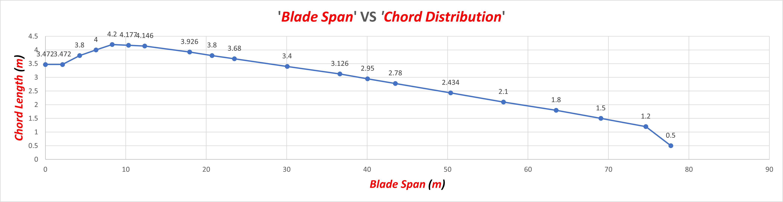
3. Spar Caps –
3.2 Developing the Blade of WEC 2025 Optimus Syria in NuMAD –
c. ‘Blade Span’ VS ‘Chord Distribution’ – (Test 4)
--------------------

Slide 9
3. Spar Caps –
3.2 Developing the Blade of WEC 2025 Optimus Syria in NuMAD –
d. Blade Material Details – (Test 4) – (Updated)
Stack ID | Stack Name | t [mm] | Ex [MPa] | Ey [MPa] | Gxy [MPa] | prxy [-] | Density [kg/m3]
1 | Gelcoat | 0.06 | 3440.00 | - | 1380.00 | 0.30 | 1235.00
2 | Triax Skins | 0.95 | 27700.00 | 13650.00 | 7200.00 | 0.39 | 1850.00
3 | Triax Root | 0.95 | 27700.00 | 13650.00 | 7200.00 | 0.39 | 1850.00
4 | UD Carbon | 0.50 | 114500.00 | 8390.00 | 5990.00 | 0.27 | 1220.00
5 | UD Glass TE | 0.50 | 41800.00 | 14000.00 | 2630.00 | 0.28 | 1920.00
6 | TE Foam | 1.2 | 256.00 | 256.00 | 22.00 | 0.30 | 200.00
7 | LE Foam | 1.2 | 256.00 | 256.00 | 22.00 | 0.30 | 200.00
8 | Saertex (DB) | 1.2 | 13600.00 | 13300.00 | 11800.00 | 0.49 | 1780.00
9 | Foam | 1.2 | 256.00 | 256.00 | 22.00 | 0.30 | 200.00
--------------------

Slide 10
3. Spar Caps –
3.2 Developing the Blade of WEC 2025 Optimus Syria in NuMAD –
e. Blade Stack of Material Details (Node 01 – Node 10) – (Test 4)
Node No | Pos [m] | Chord [m] | Airfoil | Location on Airfoil
 |  |  |  | LE | CAP | TE
1 | 0 | 3.472 | Circular_Foil | 1,2,3,2 | 1,2,3,2 | 1,2,3,2
2 | 2.129 | 3.472 | Circular_Foil | 1,2,3,2 | 1,2,3,2 | 1,2,3,2
3 | 4.258 | 3.8 | D60B_V5 | 1,2,3,2 | 1,2,4,2 | 1,2,3,2
4 | 6.283 | 4 | Interp_T52.8 | 1,2,3,7,2 | 1,2,3,4,2 | 1,2,3,5,6,2
5 | 8.308 | 4.2 | Interp_T45.0 | 1,2,3,7,2 | 1,2,3,4,2 | 1,2,3,5,6,2
6 | 10.332 | 4.177 | Interp_T42.2 | 1,2,3,7,2 | 1,2,3,4,2 | 1,2,3,5,6,2
7 | 12.357 | 4.146 | DU40B | 1,2,3,7,2 | 1,2,3,4,2 | 1,2,3,5,6,2
8 | 17.931 | 3.926 | DU40B | 1,2,3,7,2 | 1,2,3,4,2 | 1,2,3,5,6,2
9 | 20.718 | 3.8 | DU40B | 1,2,3,7,2 | 1,2,3,4,2 | 1,2,3,5,6,2
10 | 23.505 | 3.68 | DU35_A17 | 1,2,3,7,2 | 1,2,3,4,2 | 1,2,3,5,6,2
--------------------

Slide 11
3. Spar Caps –
3.2 Developing the Blade of WEC 2025 Optimus Syria in NuMAD –
e. Blade Stack of Material Details (Node 11 – Node 20) – (Test 4)
Node No | Pos [m] | Chord [m] | Airfoil | Location on Airfoil
 |  |  |  | LE | CAP | TE
11 | 30.057 | 3.4 | DU35_A17 | 1,2,3,7,2 | 1,2,3,4,2 | 1,2,3,5,6,2
12 | 36.61 | 3.126 | DU30_A17 | 1,2,3,7,2 | 1,2,3,4,2 | 1,2,3,5,6,2
13 | 40.055 | 2.95 | DU30_A17 | 1,2,3,7,2 | 1,2,3,4,2 | 1,2,3,5,6,2
14 | 43.6 | 2.78 | DU30_A17 | 1,2,3,7,2 | 1,2,4,2 | 1,2,3,5,6,2
15 | 50.39 | 2.434 | DU25_A17 | 1,2,7,2 | 1,2,4,2 | 1,2,3,2
16 | 56.943 | 2.1 | DU25_A17 | 1,2,7,2 | 1,2,4,2 | 1,2,3,2
17 | 63.495 | 1.8 | DU21_A17 | 1,2,7,2 | 1,2,4,2 | 1,2,3,2
18 | 69.059 | 1.5 | DU21_A17 | 1,2,3,2 | 1,2,4,2 | 1,2,3,2
19 | 74.643 | 1.2 | DU21_A17 | 1,2,3,2 | 1,2,4,2 | 1,2,3,2
20 | 77.75 | 0.5 | NACA 63(3)-618 | 1,2,3,2 | 1,2,2 | 1,2,3,2
--------------------

Slide 12
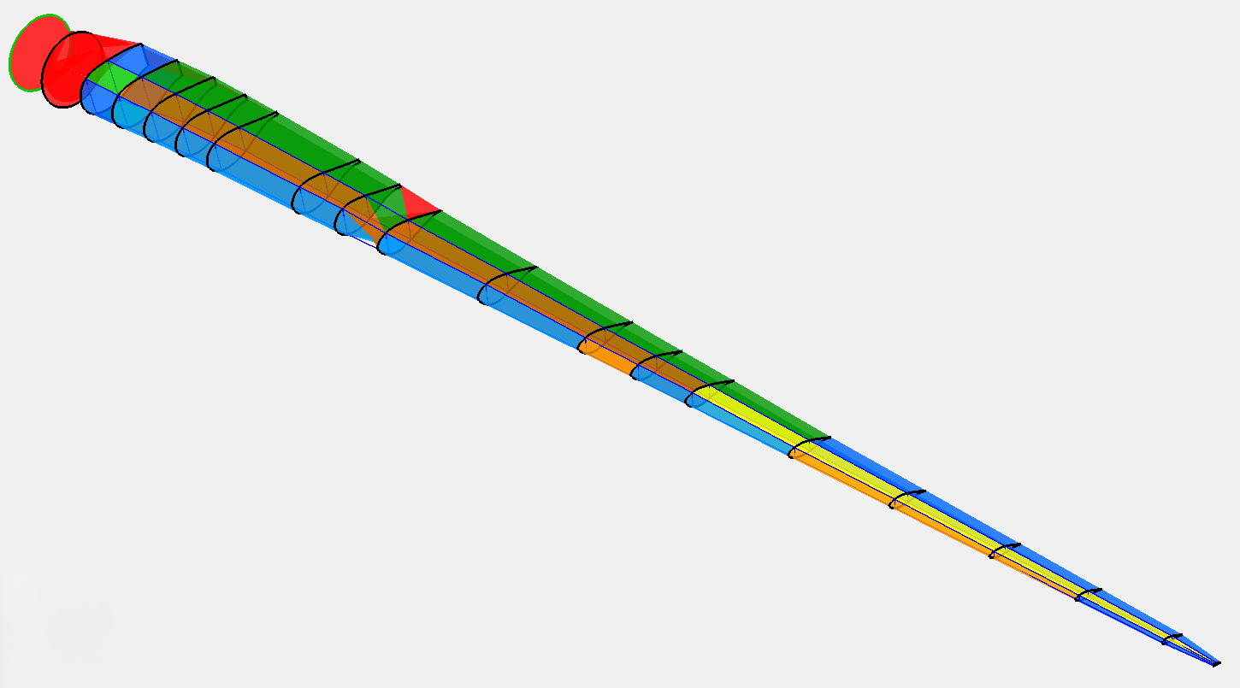
3. Spar Caps –
3.2 Developing the Blade of WEC 2025 Optimus Syria in NuMAD –
f. Blade Model in NuMAD (Solid View) – (Test 4) – (Updated)
Figure 1 – Blade Model in NuMAD
Note – This is not the final design some parameters needs to be modified later.
--------------------

Slide 13
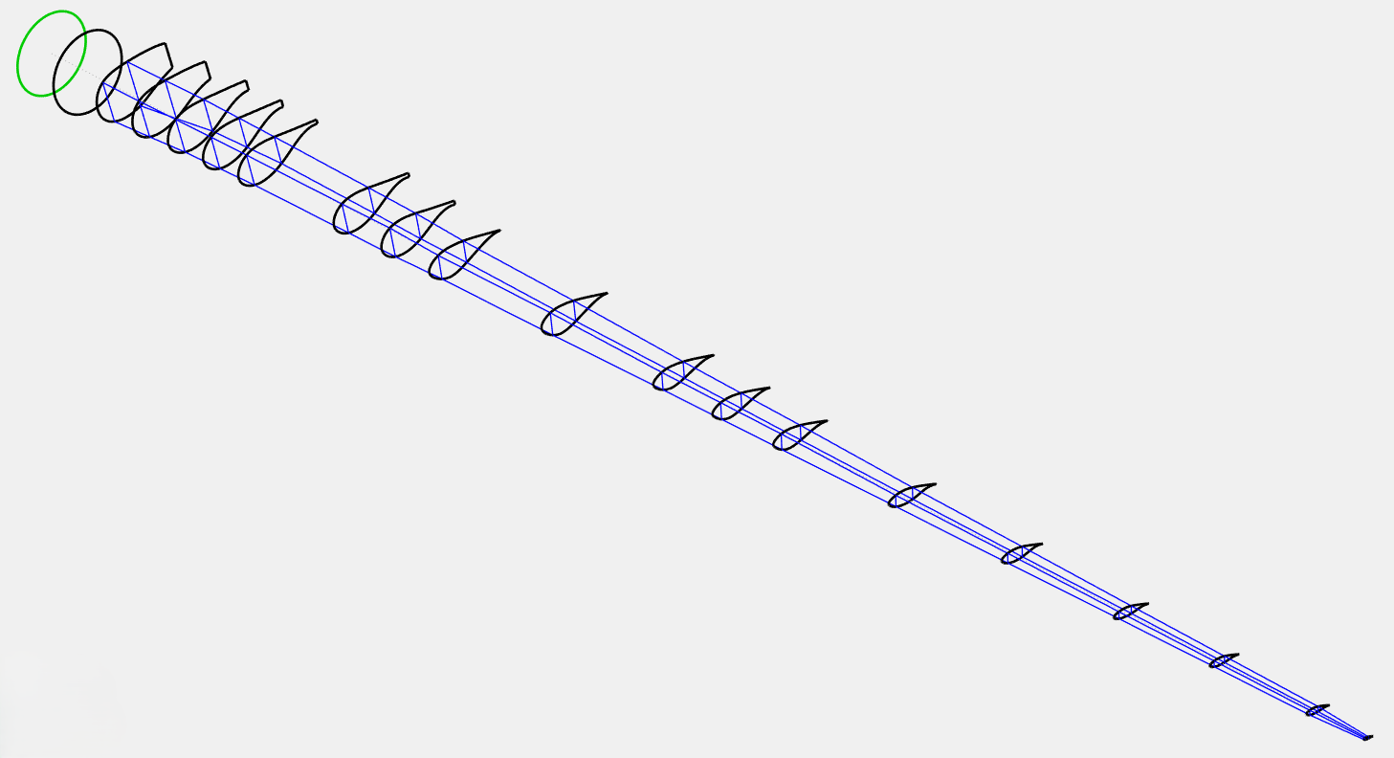
3. Spar Caps –
3.2 Developing the Blade of WEC 2025 Optimus Syria in NuMAD –
g. Blade Model in NuMAD (Outline View) – (Test 4) – (Updated)
Figure 2 – Blade Model in NuMAD
Note – This is not the final design some parameters needs to be modified later.
Bhima Babu Masare

Slide 14
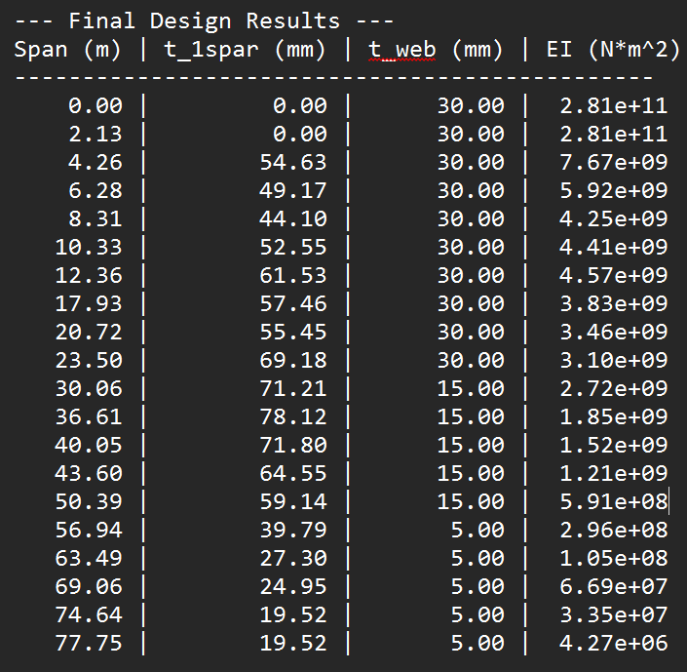
3. Spar Caps – (Update from Week 11)
3.3 Updated Results –
The result which we got after executing the MATLAB code
The Max deflection we got is 15.96 m
We have limited the maximum deflection to 8.5 m as per our design requirements by altering the thickness of these spar caps and webs
Bhima Babu Masare

Slide 15
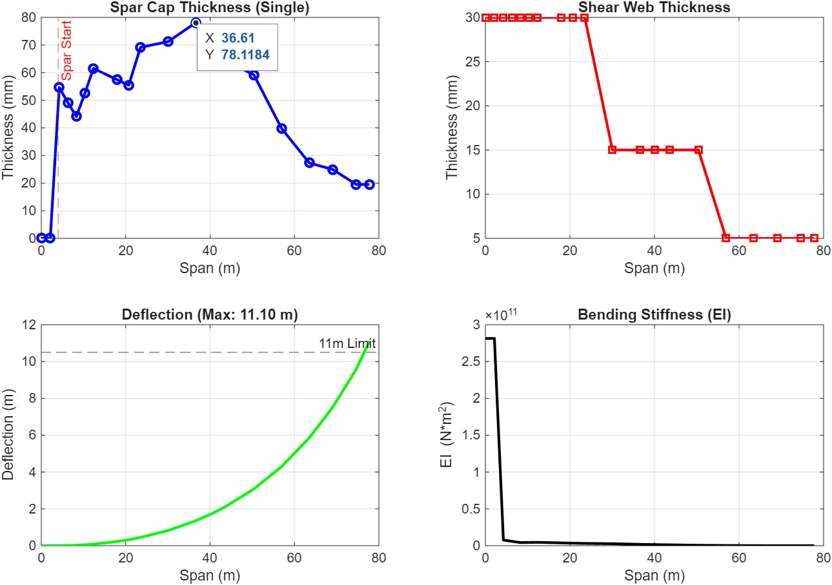
3. Spar Cap – (Update from Week 11)
3.3 Updated Results –
a. Plots from MATLAB for Bending Analysis with Deflection Limit (8.5 m) –
Bhima Babu Masare

Slide 16
Bibliography
Definition of a 5 MW/61.5m Wind Turbine Blade Reference Model by Brian R. Resor, Sandia National Laboratories, California, USA
Definition of a 5 MW Reference Wind Turbine for Offshore System Development, J. Jonkman, S. Butterfield, W. Musial, and G. Scott, National Renewable Energy Laboratory, USA
Reports from Optimus Shakthi 2024
Lecture Scripts from Prof. Dr. Francesco Previtali
Lecture Scripts from Prof. Dr. Laurence Alhrshy
Impact of Process Technology on Properties of Large-Scale Wind Turbine Blade Composite Spar Cap by Yuanrong Sun, Congli Hu, Jianbo Li
Multi-disciplinary constraint optimization of wind turbines by Carlo Luigi Bottasso, Filippo Campagnolo, Alessandro Croce
A concept study of a carbon spar cap design for a 80m wind turbine blade by Malo Rosemeier, M Bätge
Design & Analysis of Equipment for Load Introduction during Full Scale Blade Test by J. Andersen, M. Escudero, L. Larsen, J. Thuesen, A. Vissamsetty
Bhima Babu Masare

